Slide 1
F & D Projects
Submitted BY :-SHRUTI
GROUP :- 17 (2010992097) CSE
Email:-shruti2097.be20@chitkara.edu.in
Submitted to:- MR. LAVISH ARORA

Slide 2
PROJECT 1:- ELECTROSHOW -(commercial based website) -(made using HTML,CSS, javaScript)
PROJECT 2:-NEO- BAGS THAT SPEAKS FOR YOU -(handbags website)
-(made using HTML,CSS, javaScript and
additional framework BootStrap)
PROJECT 2:-PORTFOLIO -(resume)
-(made using HTML,CSS, javaScript, BootStrap)

Slide 3
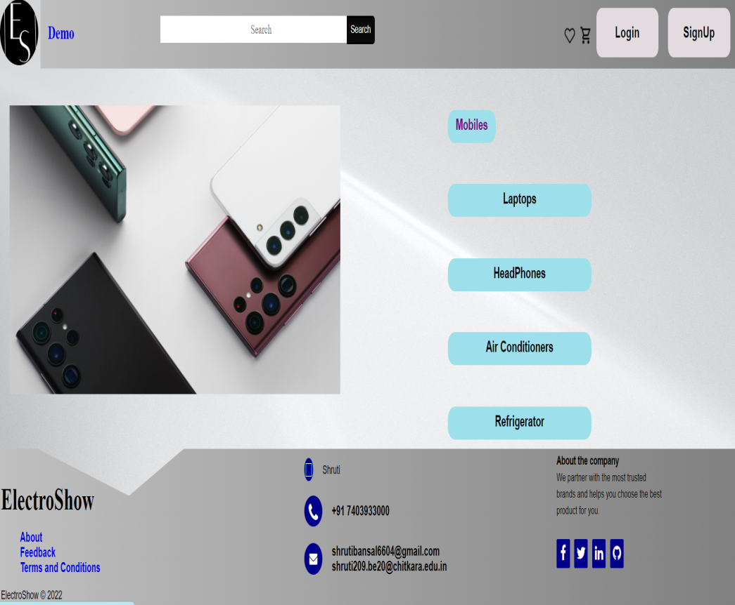
ElectroShow
HOME

Slide 4
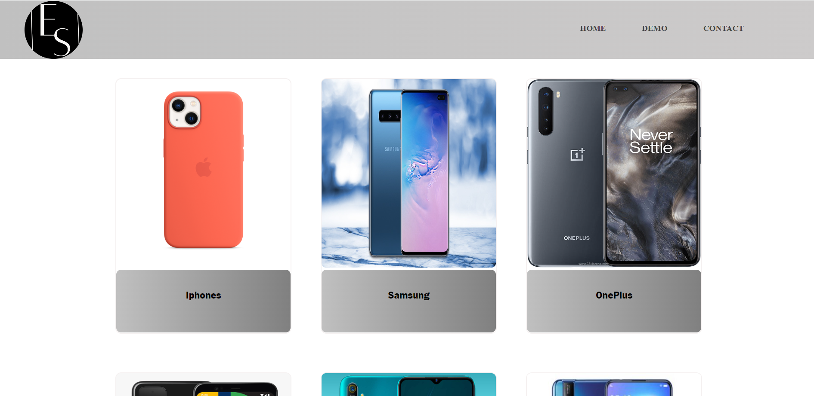
MAIN CATEGORY

Slide 5

ABOUT US
Title itself tells what the page is all about. Good domain name will create awareness and attract customers. It establishes your business as tech-savvy and forward-thinking.

Slide 6
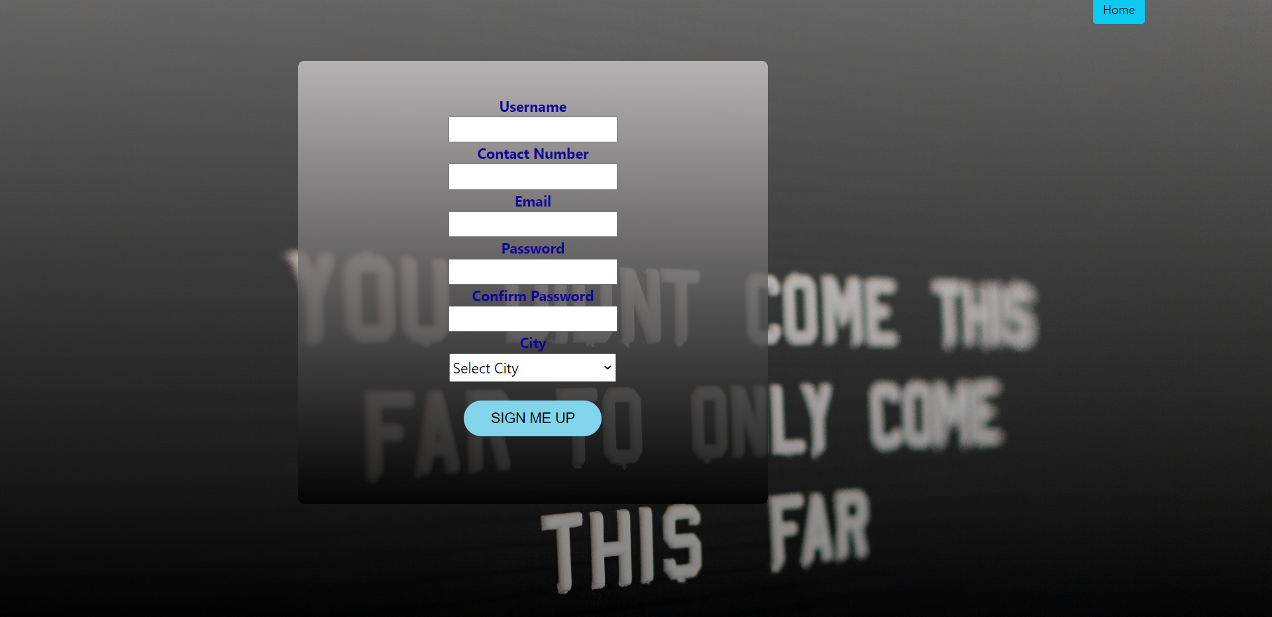
SIGN UP
Sign up page is made for new users.They enter their personal information (which is completely save with us) to access the complete features of the website.

Slide 7
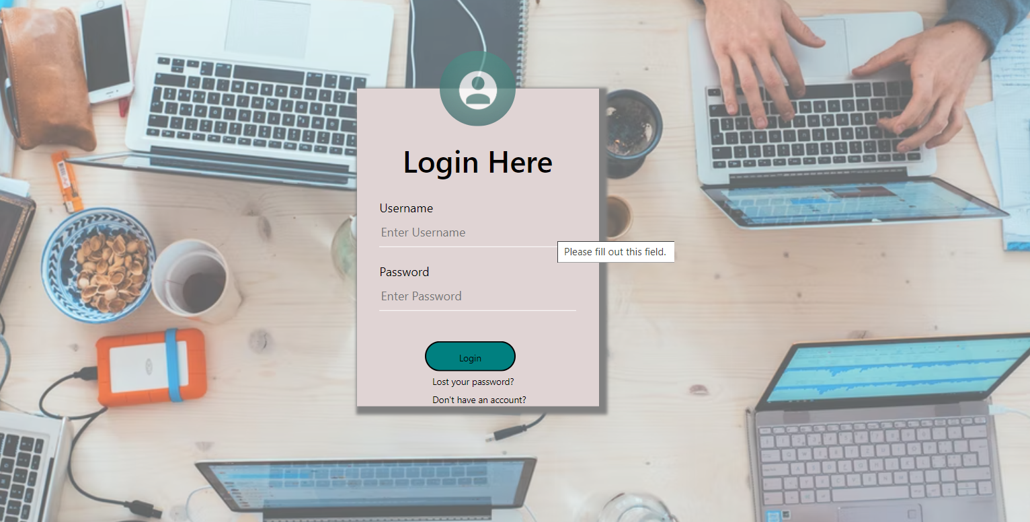
LOGIN

Slide 8
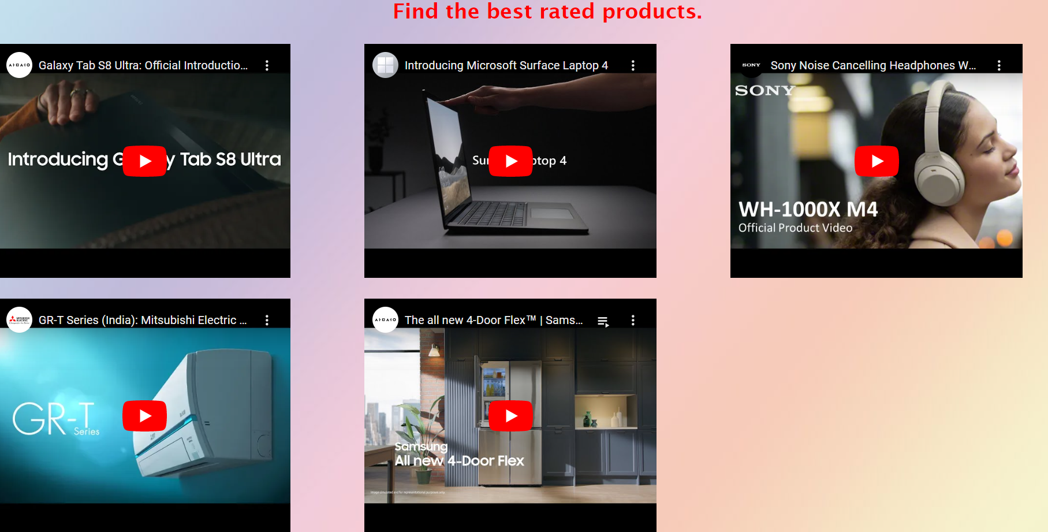
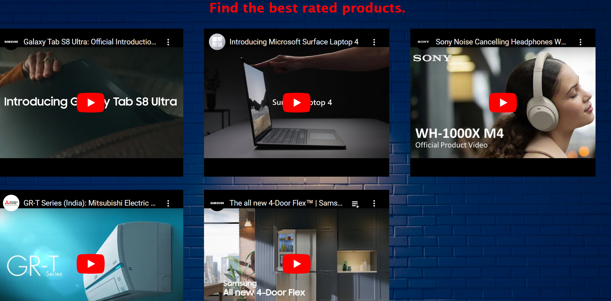
DEMO

Slide 9
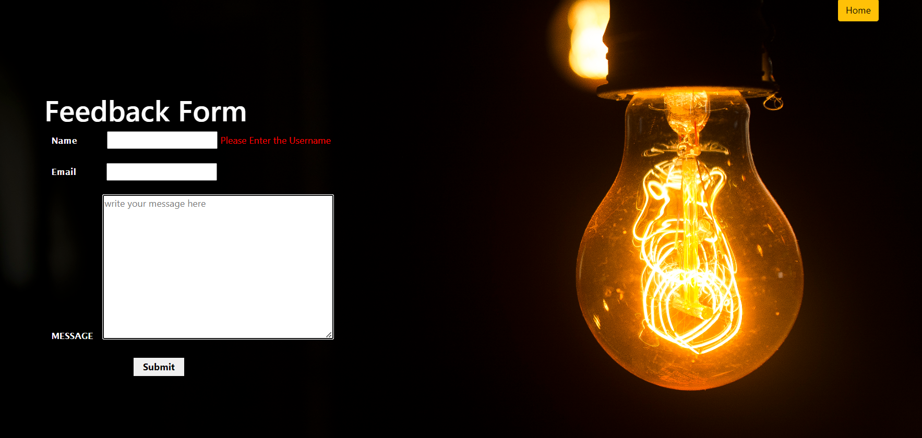
FEEDBACK FORM

Slide 10
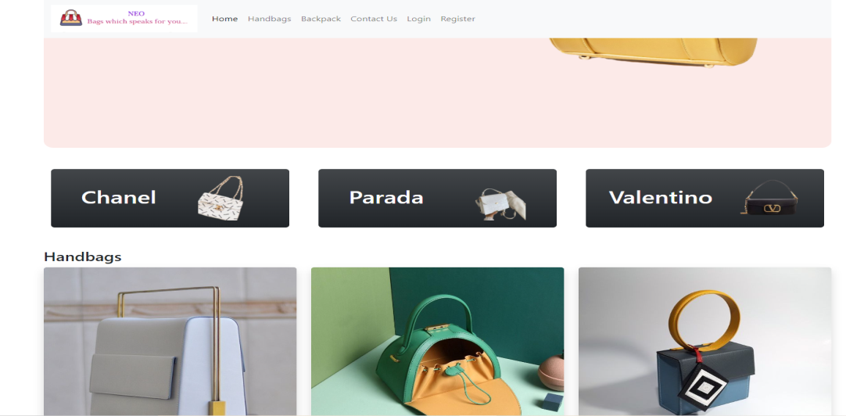

NEO- BAGS THAT SPEAKS FOR YOU HOME
NEO –title of the website means something new you will get i,e. new collection of handbags,
wallets, backpacks and more.

Slide 11
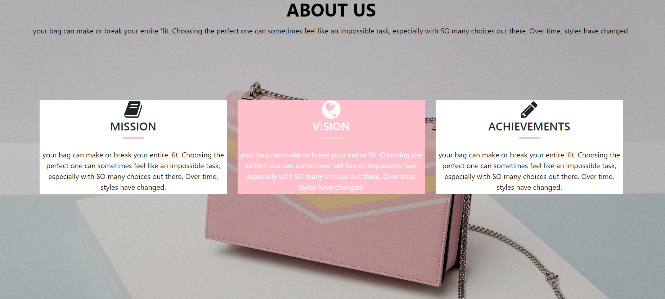
ABOUT US
Title itself tells what the page is all about. Good domain name will create awareness and attract customers. It establishes your business as tech-savvy and forward-thinking.

Slide 12
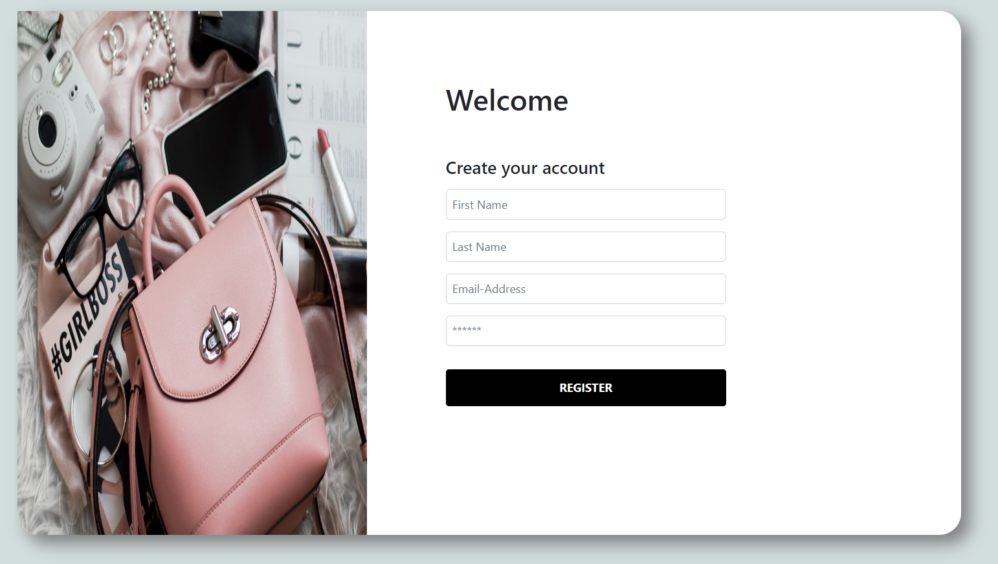
SIGN UP
Sign up page is made for new users. They enter their personal information (which is completely save with us) to access the complete features of the website.

Slide 13
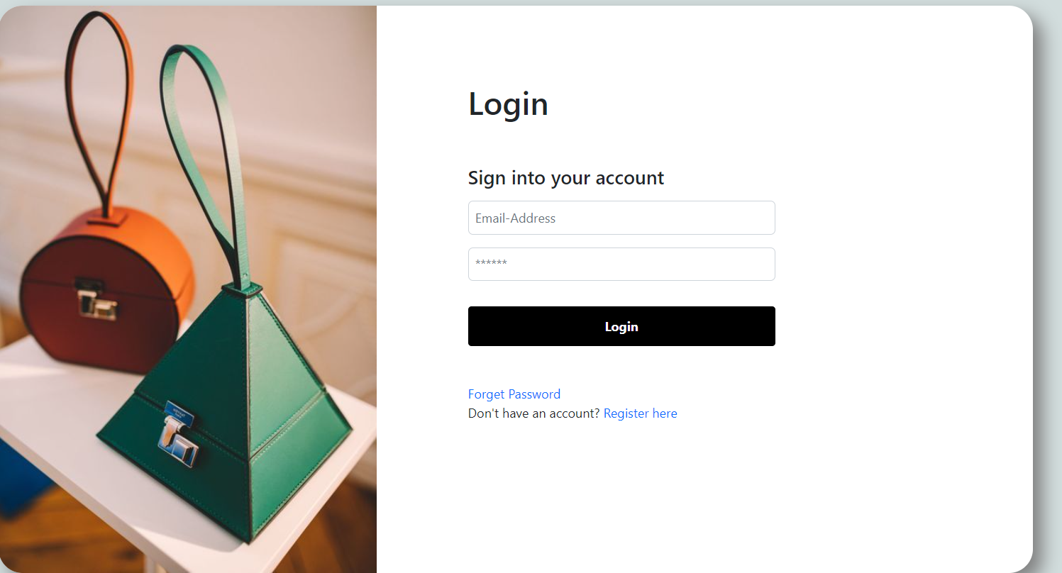
LOGIN

Slide 14
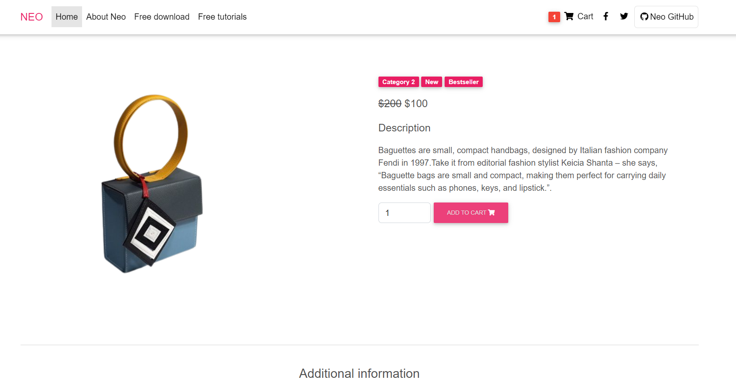
PRODUCT PAGE

Slide 15
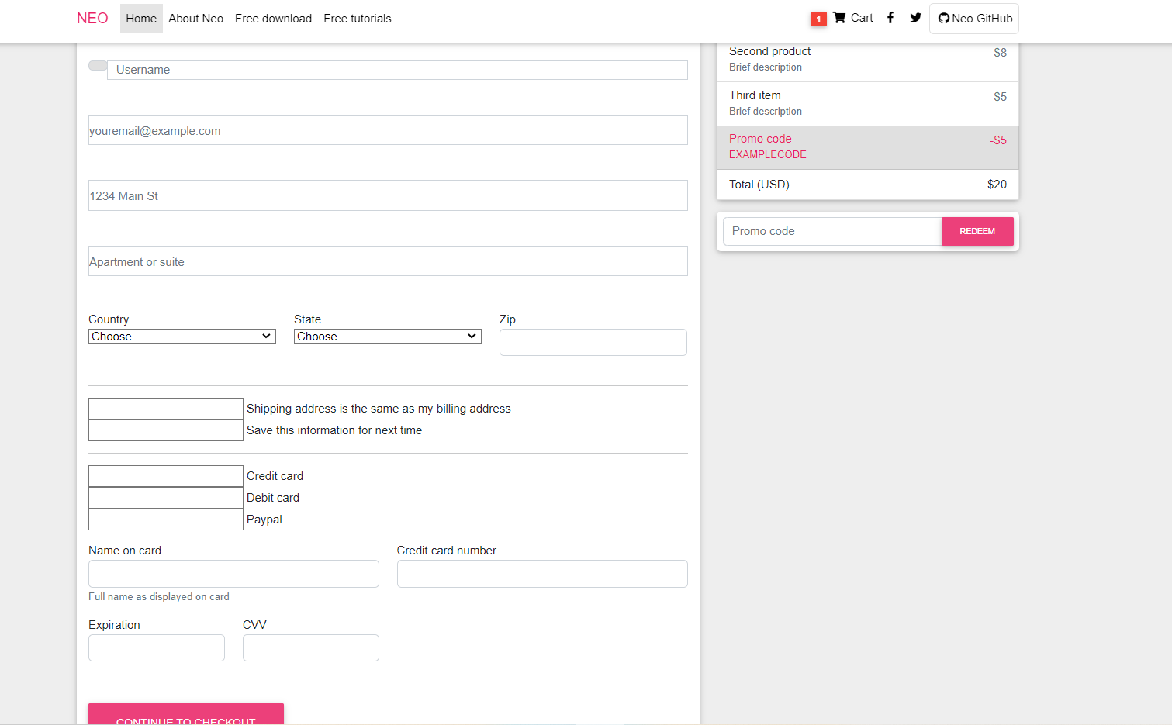
BUY-NOW

Slide 16
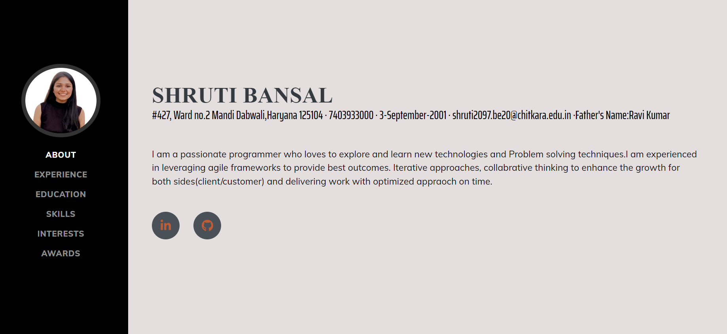
PORTFOLIO ABOUT

Slide 17
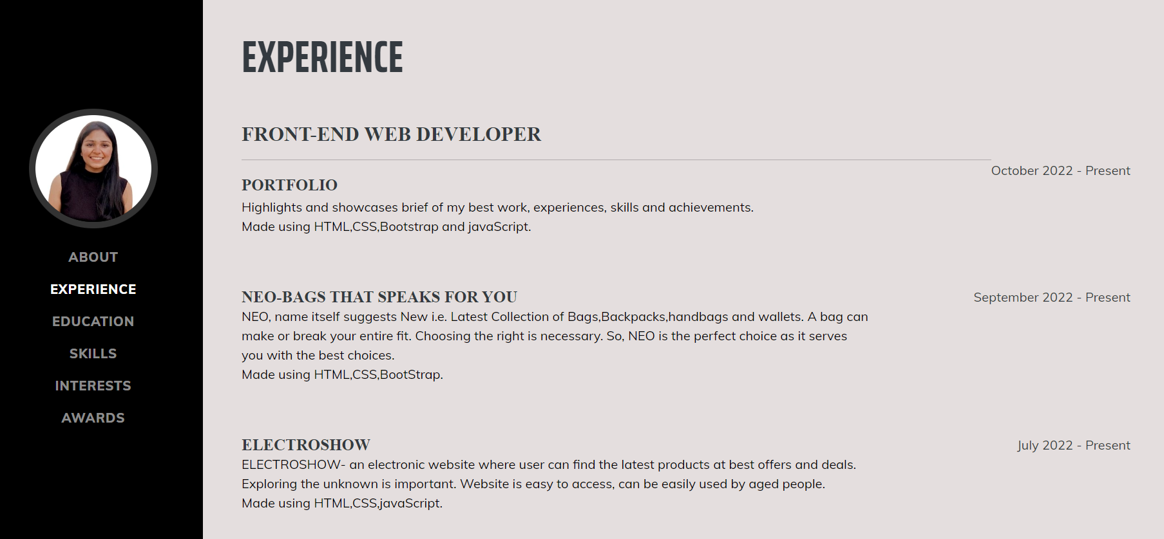
EXPERIENCE

Slide 18
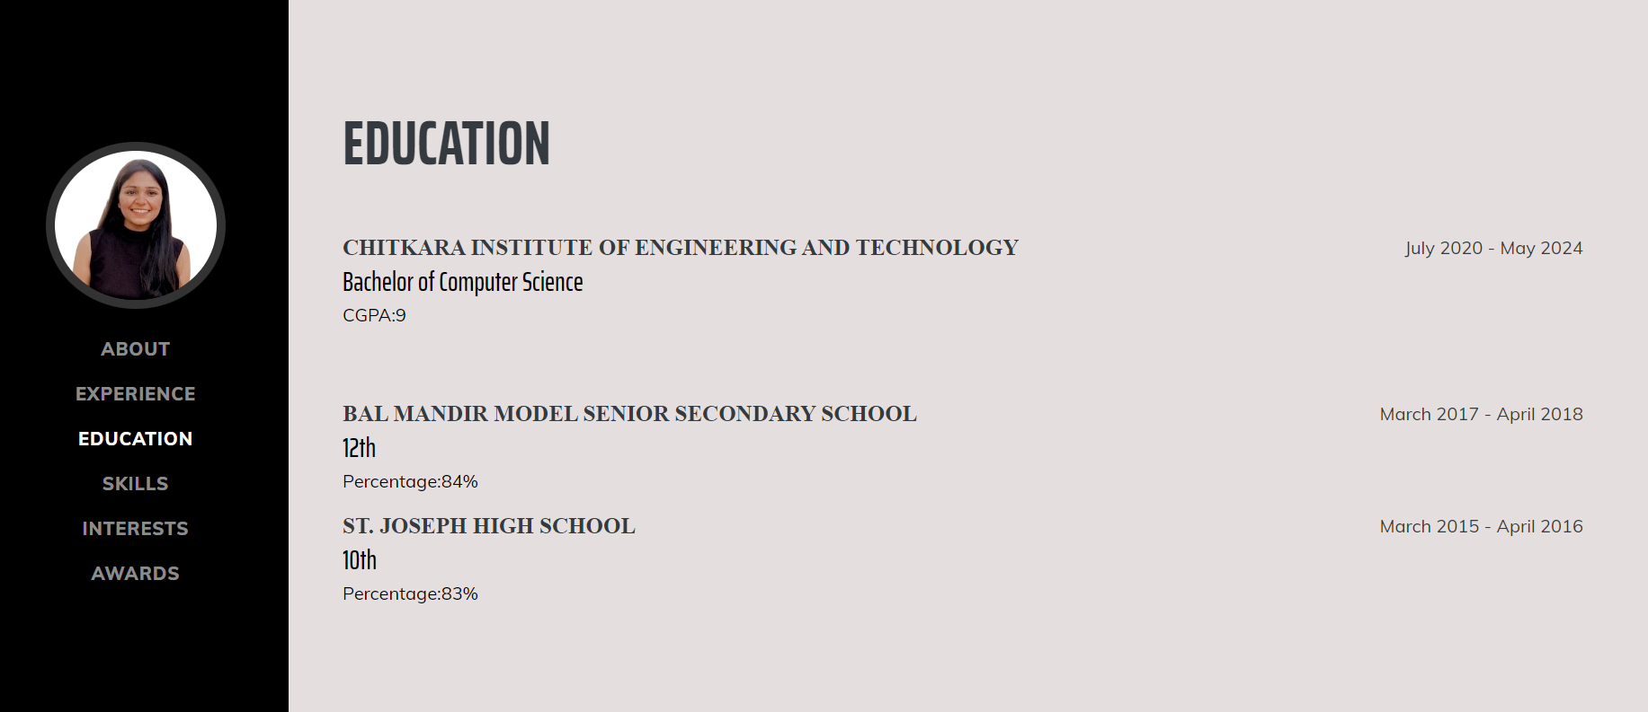
EDUCATION

Slide 19
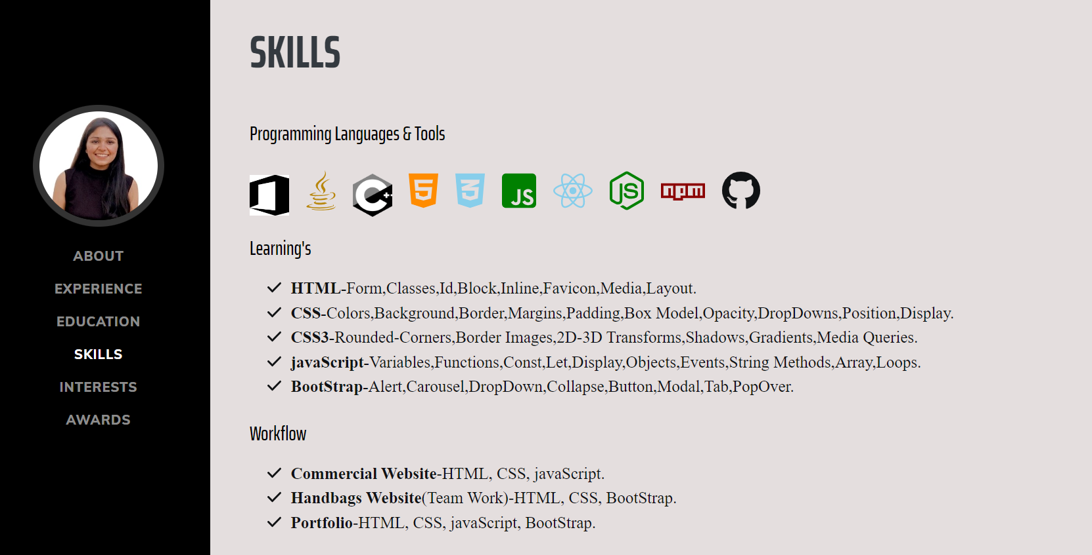
SKILLS

Slide 20
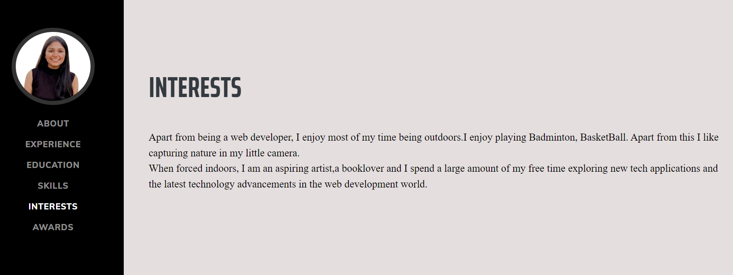
INTERESTS

Slide 21
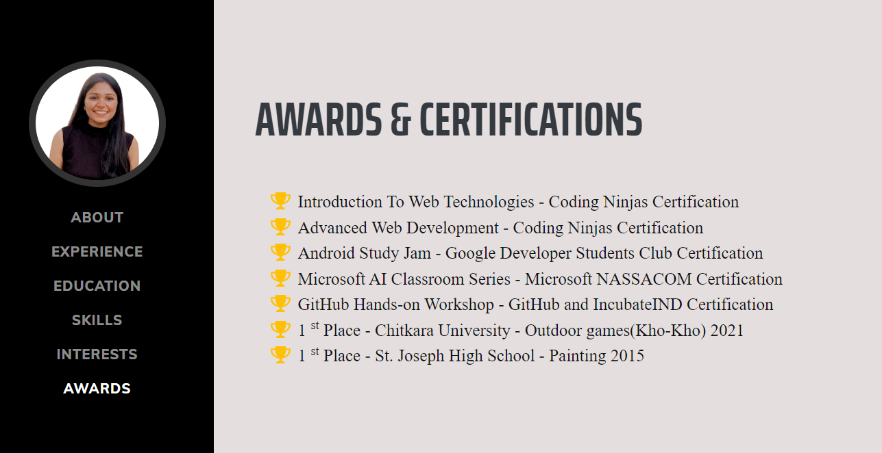
AWARDS & CERTIFICATIONS

Slide 22
THANK YOU

